Slide 1

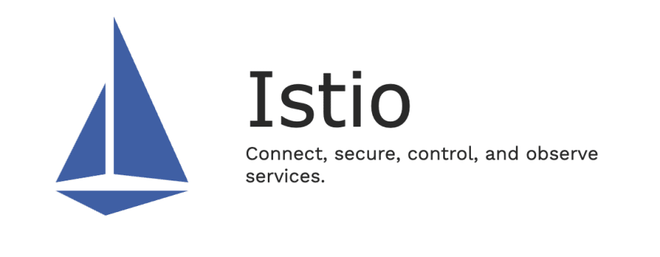
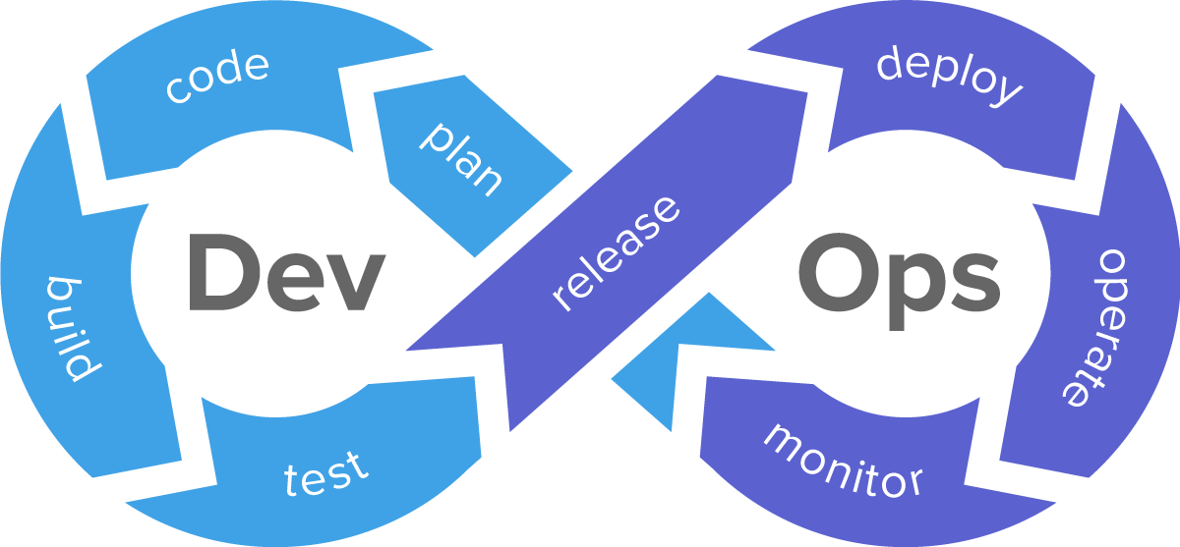

Slide 2
What is Service Mesh?
Service Mesh is a network connectivity manager, created for Kubernetes-based platforms to manage traffic flow within a cluster running workload services.

Slide 3
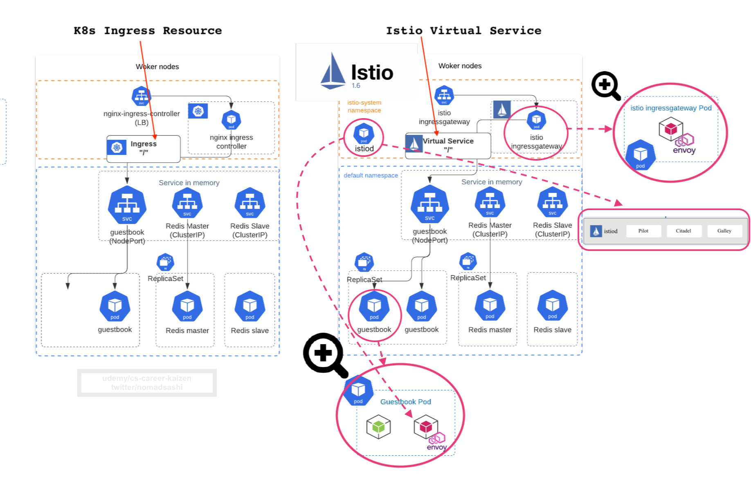
Kubernetes Ingress vs. Istio Service Mesh

Slide 4
Control Plane:
Istiod (consists of pilot, galley, and citadel)
Sidecar injection
Strong service-to-service authentication using mTLS encryption
Pilot - the core data-plane config server, propagating configuration in to sidecars
Galley - configuration watching, validation
Citadel - certificate signing, integration with CAs, service-to-service mTLS
Telemetry - component responsible for collecting telemetry metrics form running services
Policy - component responsible for enforcing policy

Slide 5
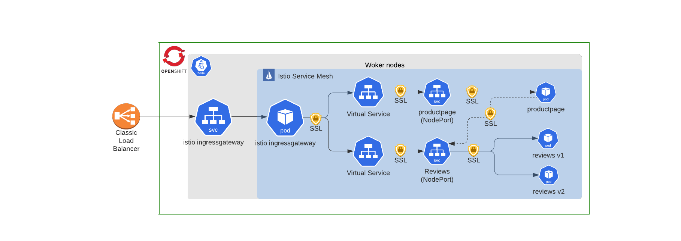
With Istio, connection among pods can be secured by mutual TLS, without changing application code.

Slide 6
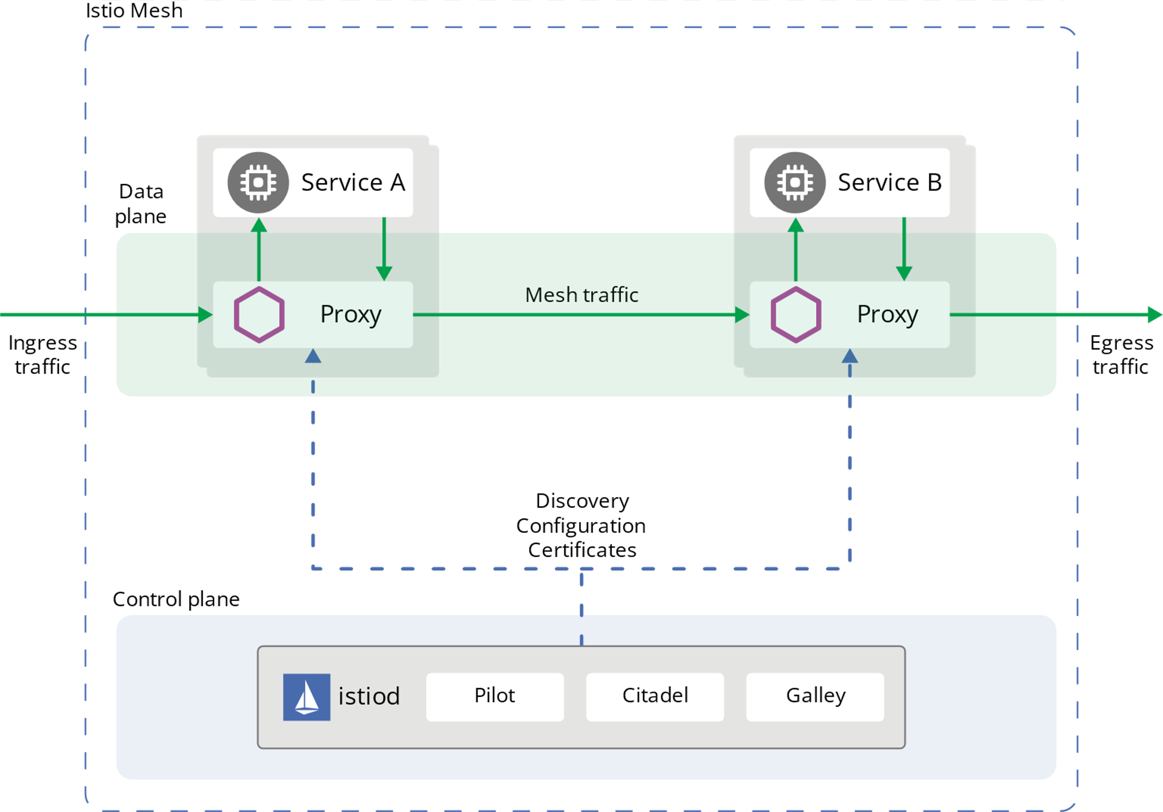
Istio Architecture

Slide 7
Data plane:
Envoy proxy: a high-performance proxy developed in C++ to mediate all inbound and outbound traffic for all services in the service mesh. Envoy proxies are the only Istio components that interact with data plane traffic.
Traffic control
A different load balancing policy to traffic for a particular subset of service instances
Staged rollouts with %-based traffic split
Istio Resources
Virtual services
Destination rules
Gateways
Service entries
Network resiliency
Fault injection
Retries
Circuit breakers
Failovers
Health checks
Security
rate limiting
TLS termination

Slide 8
Why Istio?

Slide 9
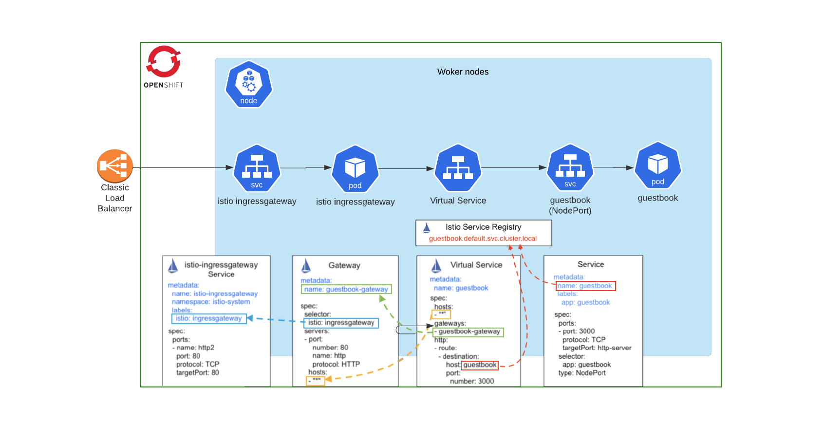
Traffic Management Control Ingress Traffic using Gateway, VirtualService, DestinationRules, ServiceEntry, Egress.

Slide 10
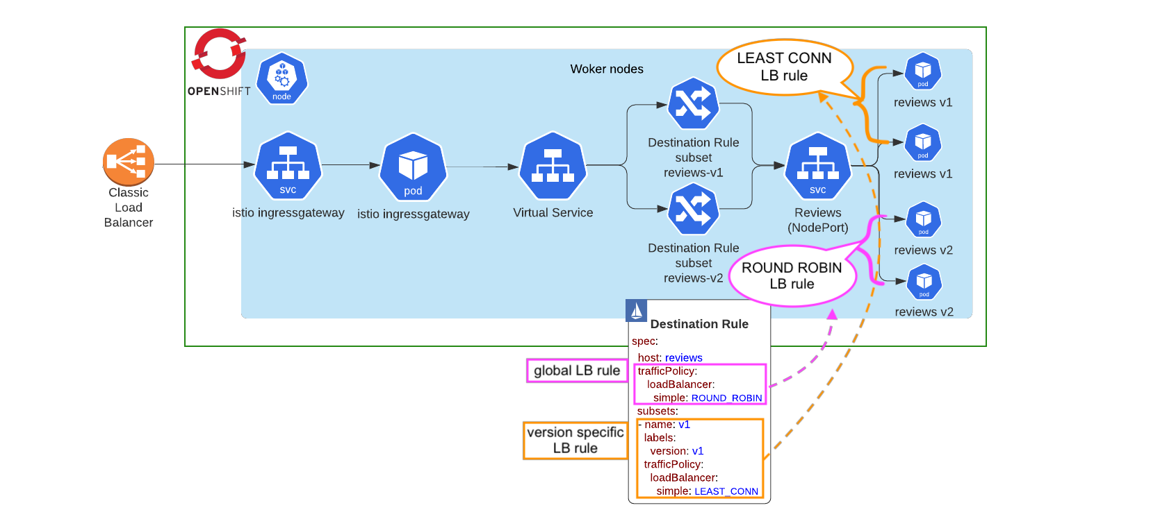
Load balancing

Slide 11
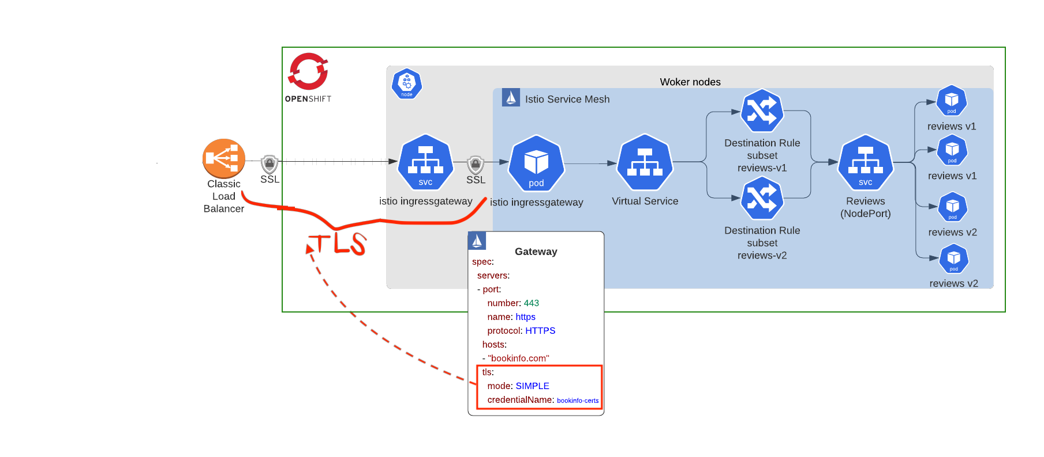
TLS termination

Slide 12
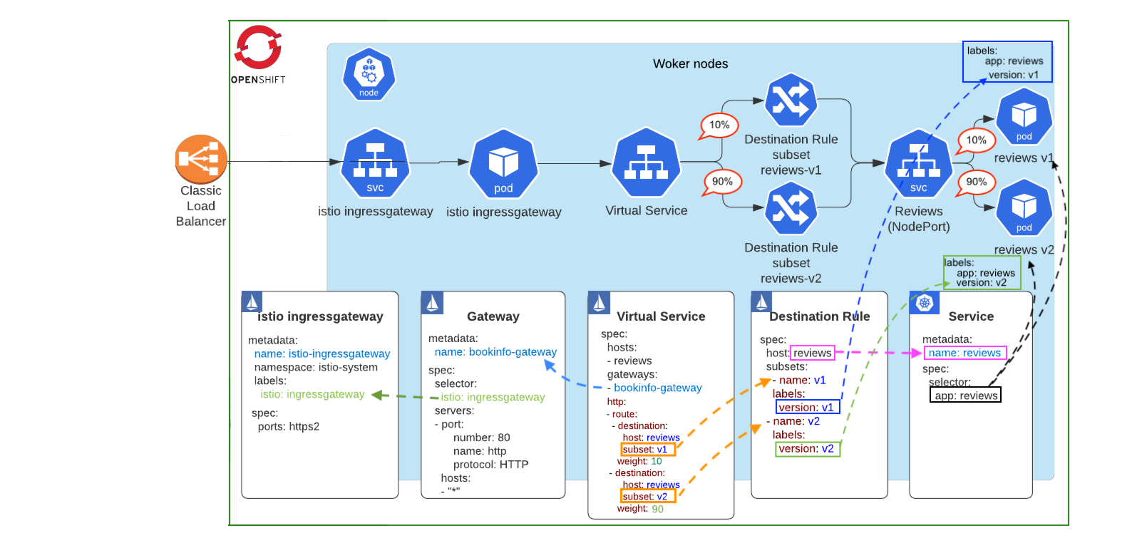
Canary rollouts

Slide 13
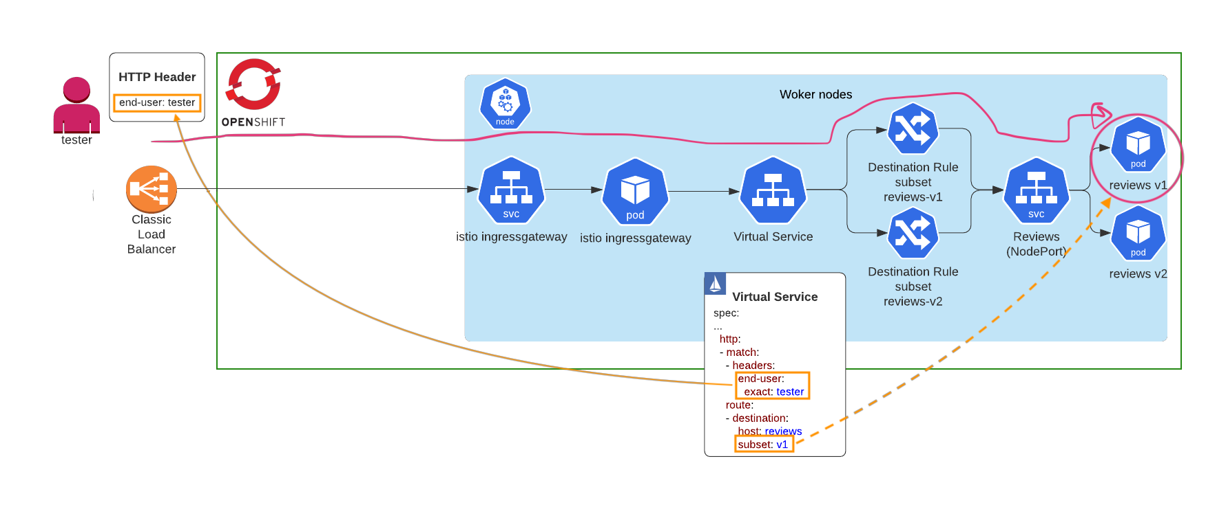
Identity/header based routing

Slide 14
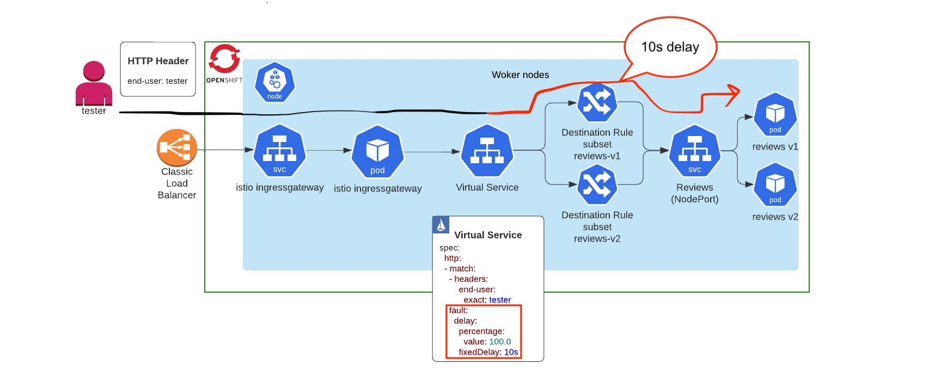
Failure recovery (delay, abort, retries, timeout)

Slide 15
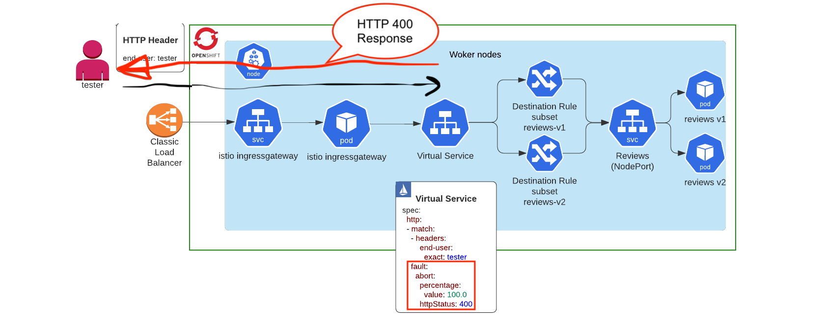
Failure recovery (delay, abort, retries, timeout)

Slide 16
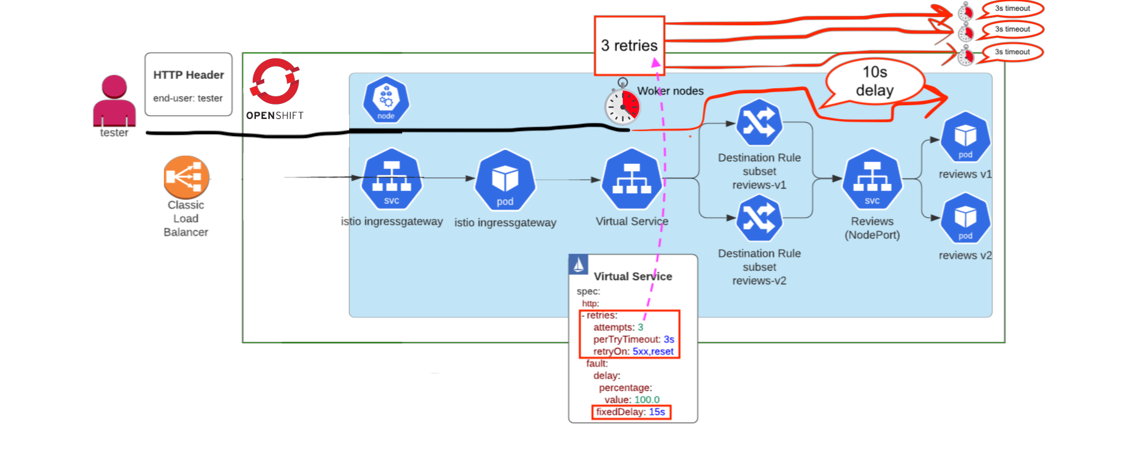
Failure recovery (delay, abort, retries, timeout)

Slide 17
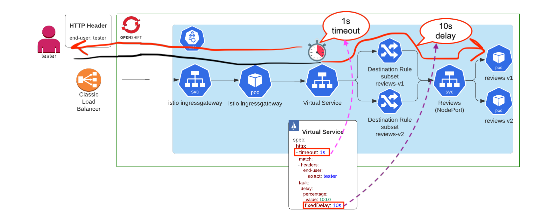
Failure recovery (delay, abort, retries, timeout)

Slide 18
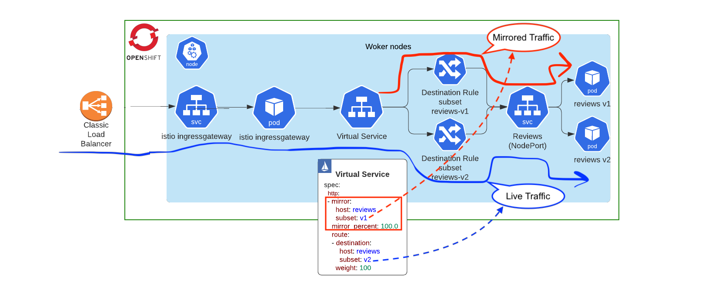
Mirror live traffic

Slide 19
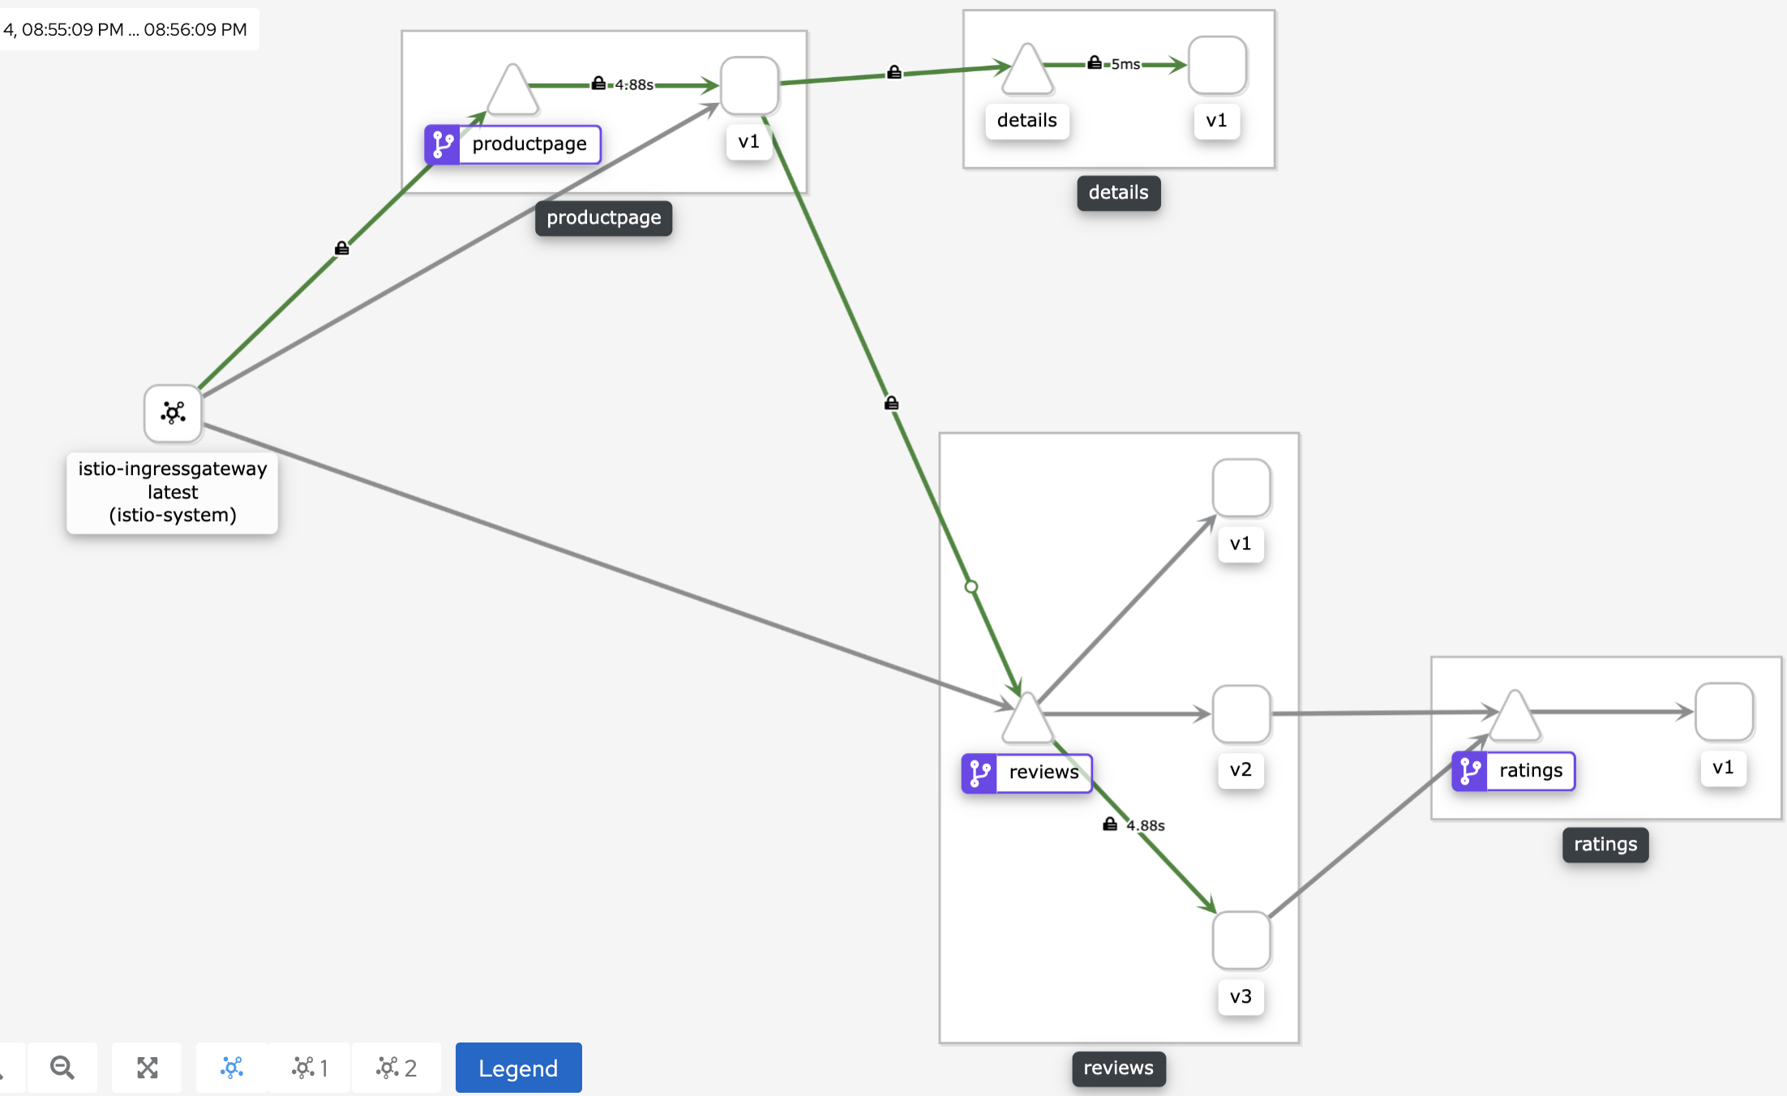
Observability

Slide 20
Thank You

